Slide 2
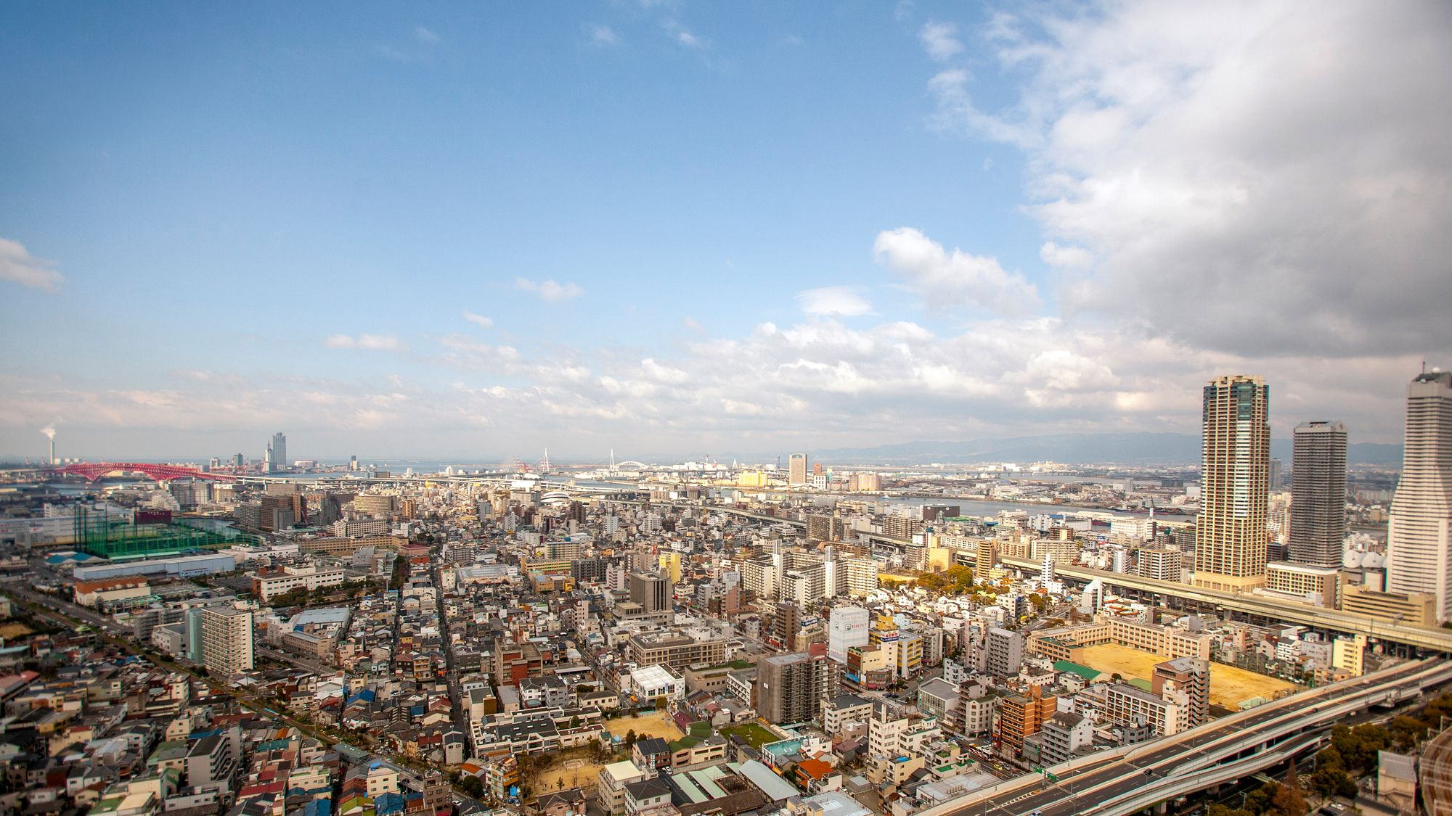
100% of your gift to the Lottie Moon Christmas Offering® supports and sustains missionary presence.
lottiemoon.com
Lottie Moon Christmas Offering® is a registered trademark of WMU®.

Slide 3
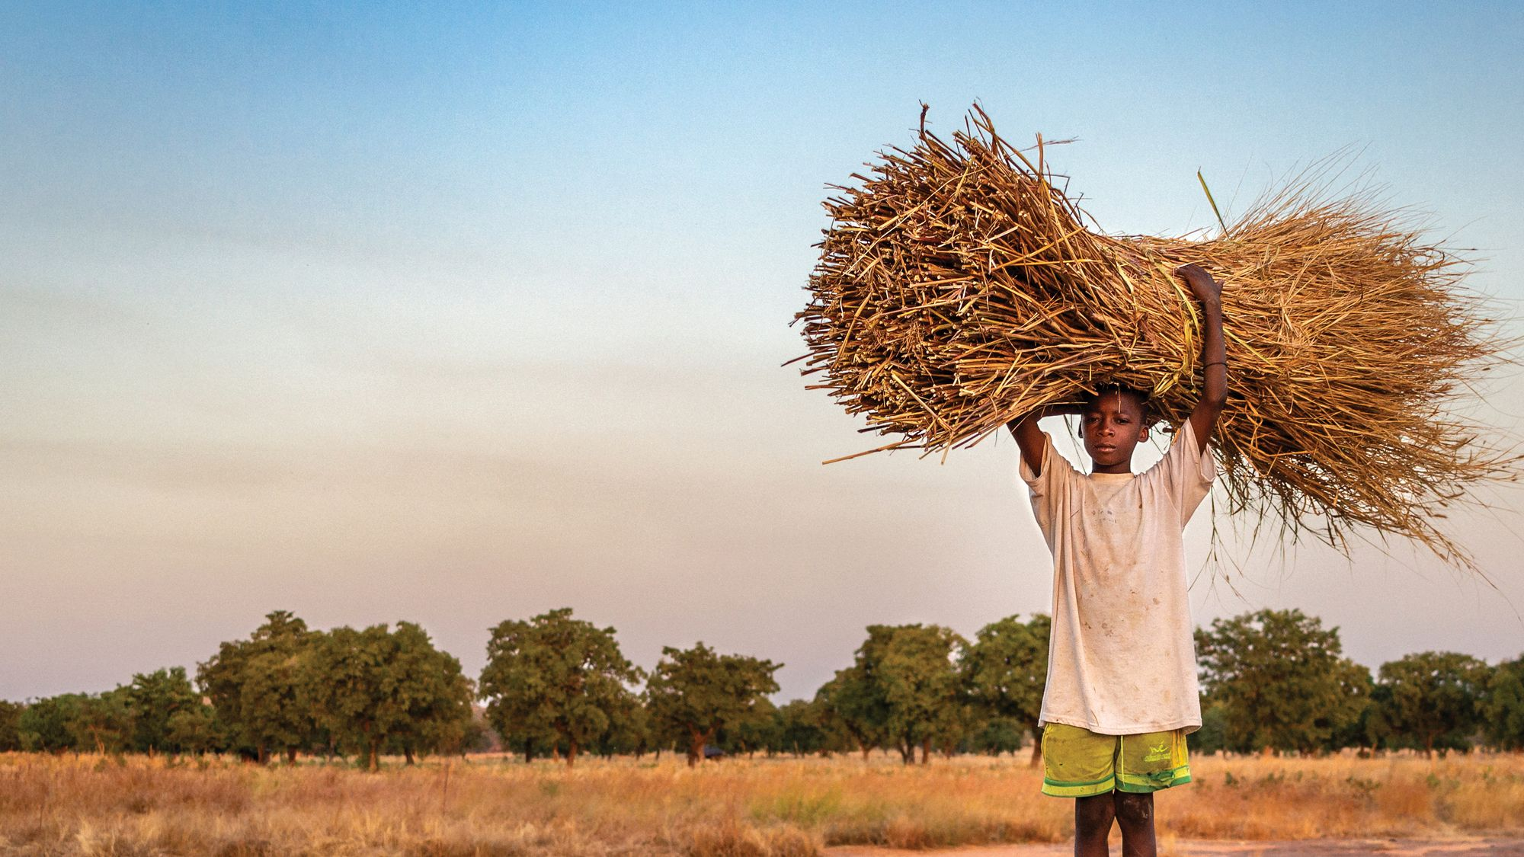
OUR CHURCH GOAL: $0,000,000
Every dollar you give goes to the mission field to support gospel transformation among the lost. Thank you for your generosity!
lottiemoon.com

Slide 4
GOD’S WORK IN 2023
116,992
BAPTISMS
269,571
DISCIPLED
141,206
NEW BELIEVERS
3,515
MISSIONARIES SUPPORTED
879,798
PEOPLE HEARD THE GOSPEL

Slide 5
lottiemoon.com

